Slide 1
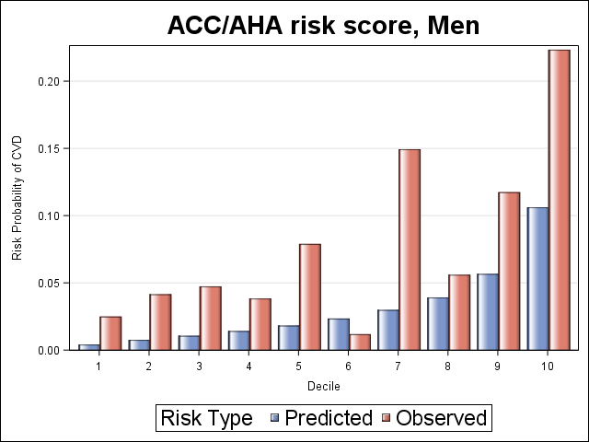
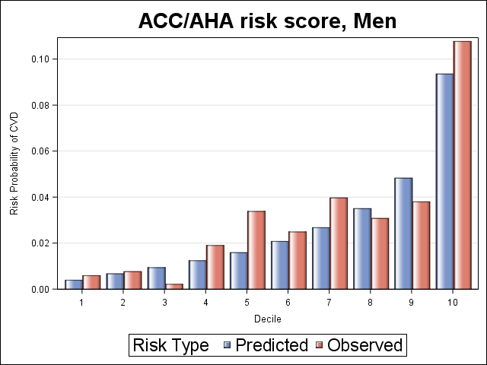
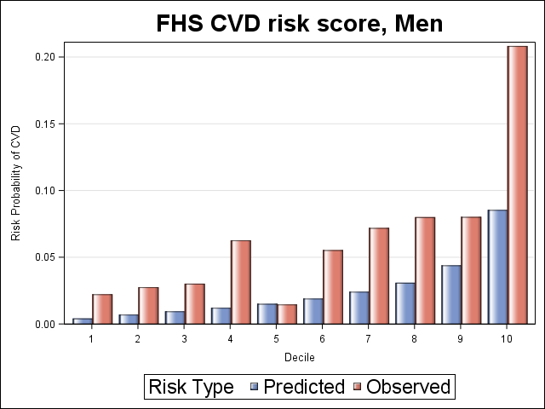
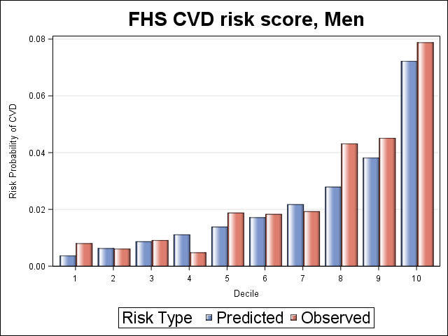
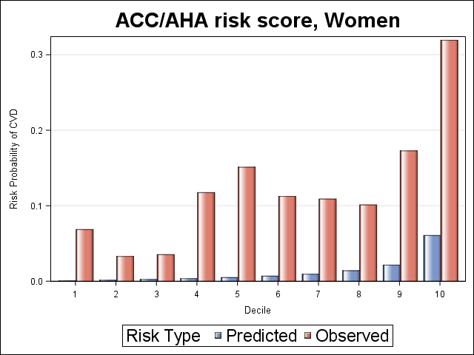
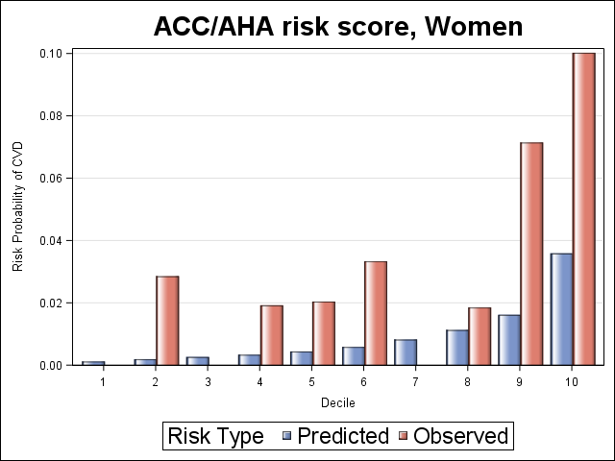
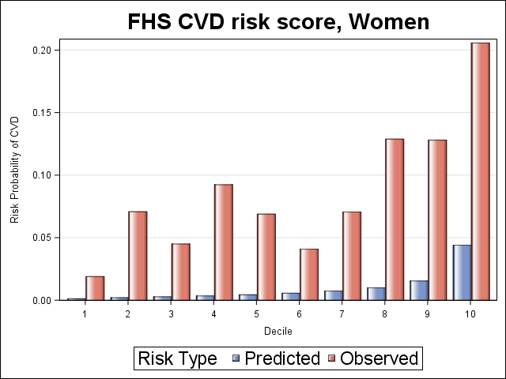
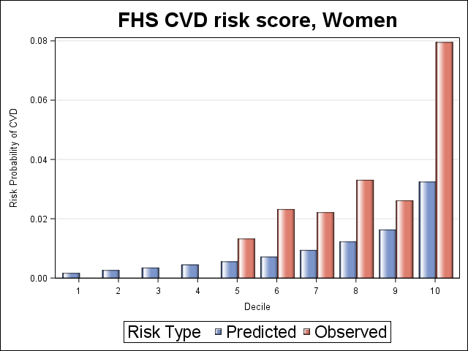
Abstract#:
PEB0187
Cardiovascular Risk Estimation is Sub-optimal Across Two HIV Cohorts
Virginia A. Triant^{1,2}, Asya Lyass^{3,} Leo B. Hurley⁴, Leila H. Borowsky⁵, Rachel Q. Ehrbar⁶, Michael J. Silverberg⁴, Joseph M. Massaro⁶, Ralph B. D’Agostino, Sr.³
¹Division of General Internal Medicine, Division of Infectious Diseases, Massachusetts General Hospital, Boston, MA; ²Harvard Medical School, Boston, MA ³Department of Mathematics and Statistics, Boston University, MA
⁴Kaiser Permanente Northern California Division of Research, Oakland, CA; ⁵Division of General Internal Medicine, Massachusetts General Hospital, Boston, MA ⁶Department of Biostatistics, School of Public Health, Boston University, MA;
BACKGROUND
Table 1. Baseline Characteristics of PLWH Age 30-79 by Cohort
Cardiovascular disease (CVD) rates are elevated in persons living with HIV (PLWH).
Established CVD risk prediction functions do not include HIV-specific risk factors and may not accurately predict risk in PLWH.
A prior study demonstrated discrimination and calibration to be moderate to poor in male PLWH in the Partners HIV Cohort.
In the current study, we assessed the performance of three established CVD risk prediction functions in women and men in two clinically and geographically discrete HIV cohorts.
 | Partners | KPNC
 | (N=2185) | (N=7938)
Age (yrs) - mean+/-SD | 44.1 ± 8.1 | 46.0 ±8.9
Female - % | 24.2 | 10.2
Race/ethnicity - %
White | 50.8 | 52.2
Black | 26.5 | 14.9
Hispanic | 12.7 | 18.5
Other/Unknown | 10 | 14.4
Cohort entry year - median (Q1, Q3) | 2006 (2002, 2010) | 2010 (2007, 2014)
Total cholesterol (mg/dL) - mean+/-SD | 174.6 ± 50 | 183.6 ±42.3
HDL cholesterol (mg/dL) - mean+/-SD | 42.3 ± 15.8 | 44.4 ±13.6
Systolic blood pressure – mean+/-SD | 123 ± 16.4 | 123.5 ±14.9
Antihypertensive medication - % | 27.7 | 26.7
Smoking - % | 43.8 | 20.9
Diabetes - % | 8.2 | 5.7
CD4 count - median (Q1, Q3) | 437 (262, 657) | 509 (333, 703)
CD4 count < 200 cells/mm3 - % | 17.8 | 10.6
HIV viral load < 400 copies/mL - % | 47.8 | 74.0
ART use - % | 79.2 | 81.6
Figures 1a-b Predicted vs. Observed Risk: Partners Men
Figures 2a-b Predicted vs. Observed Risk: KPNC Men
METHODS
Study Population
The Partners HIV population was derived from the Partners HIV Cohort, a longitudinal observational cohort of PLWH receiving care through the Mass General Brigham health care system.
The Kaiser Permanente Northern California (KPNC) HIV Cohort was derived from a clinic-based cohort of persons enrolled in KPNC, a large integrated healthcare system in Northern California serving 4.4 million people in the San Francisco Bay Area.
Patients who received care between 1/1/2000 and 1/31/2020 were eligible for inclusion.
Study Design and Outcomes
Index date was defined as the earliest date lipid values were available after 1/1/2000.
PLWH age 30-79 at index date were included and those with history of coronary heart disease (CHD) or stroke prior to index date were excluded.
Observation was from index date through the earliest of clinical outcome, death, last follow-up visit, or 1/31/2020.
Follow-up was truncated at 5 years.
CVD risk scores included:
American College of Cardiology/American Heart Association (ACC/AHA) atherosclerotic CVD (ASCVD) risk estimator
Framingham Heart Study (FHS) function for hard coronary heart disease (CHD)
Framingham Heart Study (FHS) function for global cardiovascular disease (CVD), using an adjustment factor to accommodate ASCVD outcome
Outcomes were myocardial infarction (MI) or coronary death (Framingham CHD function) and MI, stroke or coronary death (ASCVD and Framingham Global CVD functions), ascertained by ICD codes.
Statistical Analysis
Predictive ability of each of the risk functions was assessed for each cohort by the c-statistic (discrimination) and by the goodness-of-fit of predicted risk to observed risk (calibration) separately among men and women.
The observed and predicted 5-year risk by decile of predicted risk for the ACC/AHA and FHS Global CVD functions were calculated for each cohort.
SD indicates standard deviation; mg, milligrams; dL, deciliter; HDL, high-density lipoprotein; Q1, quarter 1; Q3, quarter 3; ART, antiretroviral therapy
.
Table 2. Performance of Five-Year Risk Scores by Cohort
Partners | N | Follow-up | Events | Incidence Rate | Risk Score % | C-statistic | Chi-Square Statistic | Chi-square (p)
 |  | Median (Q1, Q3) |  | (per 1000 PY) | Median (Q1, Q3)
Framingham Hard CHD
Women | 527 | 5 (3.1, 5.0) | 20 | 9.59 | 0.3 (0.2, 0.8) | 0.682 | 14.51 | 0.0007
Men | 1656 | 5 (2.3, 5.0) | 49 | 7.94 | 1.4 (0.8, 2.6) | 0.689 | 11.14 | 0.0487
ACC/AHA ASCVD
Women | 315 | 5 (2.5, 5.0) | 33 | 27.81 | 0.6 (0.3, 1.4) | 0.652 | 30.56 | <.0001
Men | 1130 | 5 (2.2, 5.0) | 70 | 16.88 | 2.0 (1.1, 3.9) | 0.689 | 31.09 | <.0001
Framingham CVD
Women | 527 | 5 (2.8, 5.0) | 39 | 19.11 | 0.5 (0.3, 1.0) | 0.664 | 33.74 | <.0001
Men | 1656 | 5 (2.2, 5.0) | 85 | 13.99 | 1.7 (1.0, 3.1) | 0.686 | 35.88 | <.0001
KPNC | N
Framingham Hard CHD
Women | 809 | 4.4 (1.5, 5.0) | 3 | 1.10 | 0.3 (0.2, 0.7) | NA | NA | NA
Men | 7111 | 3.8 (1.5, 5.0) | 61 | 2.64 | 1.3 (0.7, 2.2) | 0.740 | 19.52 | 0.0015
ACC/AHA ASCVD
Women | 552 | 5 (1.7, 5.0) | 12 | 6.25 | 0.5 (0.3, 1.1) | 0.743 | 5.73669 | 0.0166
Men | 5209 | 4 (1.6, 5.0) | 110 | 6.33 | 1.8 (0.9, 3.5) | 0.719 | 7.24 | 0.4047
Framingham CVD
Women | 809 | 4.4 (1.5, 5.0) | 12 | 4.43 | 0.6 (0.4, 1.2) | 0.815 | 3.35 | 0.0673
Men | 7111 | 3.8 (1.4, 5.0) | 120 | 5.21 | 1.5 (0.9, 2.9) | 0.728 | 5.68 | 0.5771
Figures 3a-b Predicted vs. Observed Risk: Partners Women
Figures 4a-b Predicted vs. Observed Risk: KPNC Women
Q1, quarter 1; Q3, quarter 3; PY, person years;
Strengths
The study population was drawn from two large and well-established HIV cohorts.
The cohorts represented clinically and geographically distinct populations.
The multidisciplinary research team included experts in cardiovascular risk prediction modeling.
Limitations
Follow-up was limited to 5-years.
Outcome ascertainment may have been limited by out-of-system events.
Event numbers among women were low.
STRENGTHS AND LIMITATIONS
RESULTS
Demographic and clinical characteristics by cohort are shown in Table 1.
There were 2185 in the Partners Cohort and 7938 individuals in the KPNC Cohort. Event numbers, incidence rates, and median risk scores are shown in Table 2.
Discrimination, assessed using c statistic, was suboptimal for men and women in Partners for all three functions, moderate for men in KPNC for all three functions and moderate for women in KPNC for the FHS Global CVD and ACC/AHA function.
Calibration was poor for both men and women in Partners for all three functions, for women in KPNC for the FHS CVD and ACC/AHA functions and for men for FHS CHD function. Discrimination or calibration could not be assessed for women in KPNC for the FHS CHD function due to low event numbers.
In the KPNC cohort, calibration or model fit was moderate for ACC/AHA and FHS Global CVD functions in men.
Observed vs. predicted plots by decile of risk (Figures 1 - 4) show both ACC/AHA and FHS Global CVD risk functions to under-predict the risk of corresponding events among women and men.
CONCLUSIONS
Established CVD risk prediction functions do not provide a good fit overall for PLWH.
Calibration differed by sex, with more pronounced underestimation of risk among women across functions.
Discrimination differed by site, with higher c-statistics for KPNC indicating better discrimination across functions.
Cardiovascular risk prediction functions developed for the general population are not uniformly transportable to PLWH, and their performance further differs among PLWH by sex and health care system where care is received. The results underscore the need for both HIV-specific and sex-specific functions to ensure equity in the delivery of preventative care.
Funding acknowledgement: R01HL132786 (NHLBI)
PRESENTED AT THE 23RD INTERNATIONAL AIDS CONFERENCE (AIDS 2020) | 6-10 JULY 2020
Contact Information:
Virginia A. Triant, MD, MPH,
Massachusetts General Hospital 100 Cambridge St, Ste 1600, Boston, MA 02114. E-mail vtriant@mgh.harvard.edu
Boston University
Logo here

